Slide 1
Android UI design
Jilin University

Slide 2
Hierarchical clustering parameter recording
The number of clusters：n_clusters,
Connection metric option, cluster spacing calculation method：affinity='euclidean'
Connection method：linkage='complete'
Adjustable parameters：n_clusters
 | n_clusters | Abnormity point
0 | 5 | 3498
1 | 50 | 1532
2 | 100 | none

Slide 3
Summary of records
The selected hierarchical clustering method is Agglomerative Clustering in sklearns, which is a bottom-up agglomerative clustering method.
The number of adjustable parameters is set to 5 and 50，100 respectively.When set to 5, there is a problem of too large a cluster. According to DBscan clustering results, the cluster number is set to 50, and the maximum cluster number contains 1532 data sets. After observation, although the cluster number is large, most UIs are very similar. In the third test, a comparative experiment was set up, and the number of clusters was set to 100. There was no problem that the number of clusters was too large.

Slide 4
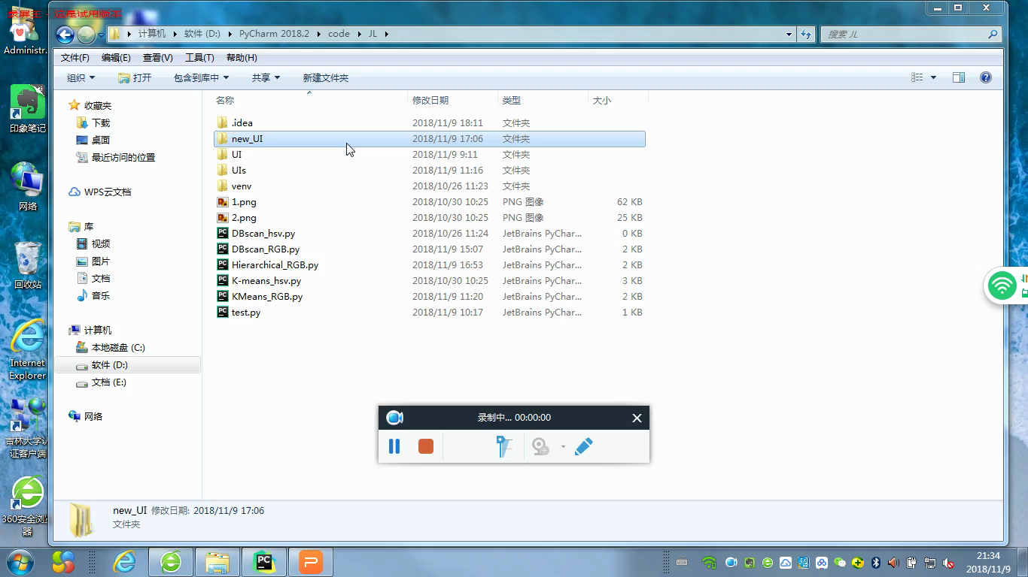
n_clusters=50

Slide 5
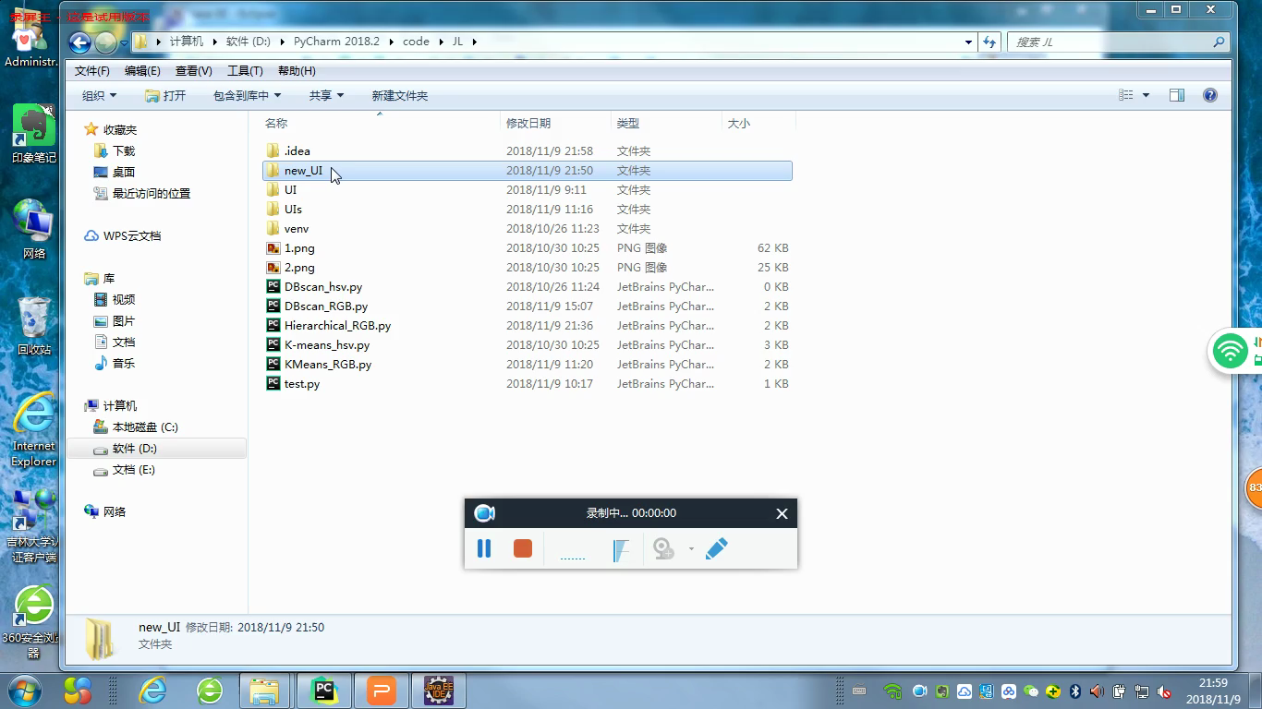
n_clusters=100

